Slide 1
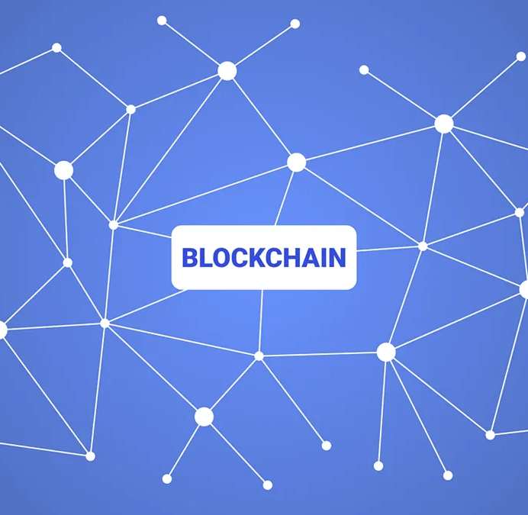
Blockchain
A blockchain is a growing list of records called blocks which are interconnected by utilizing cryptography.

Slide 2

History of blockchain
Blockchain was invented by a person (or group of people) using the name Satoshi Nakamoto in 2008 to serve as the public transaction ledger of the cryptocurrency bitcoin. The identity of Satoshi Nakamoto is unknown.

Slide 3
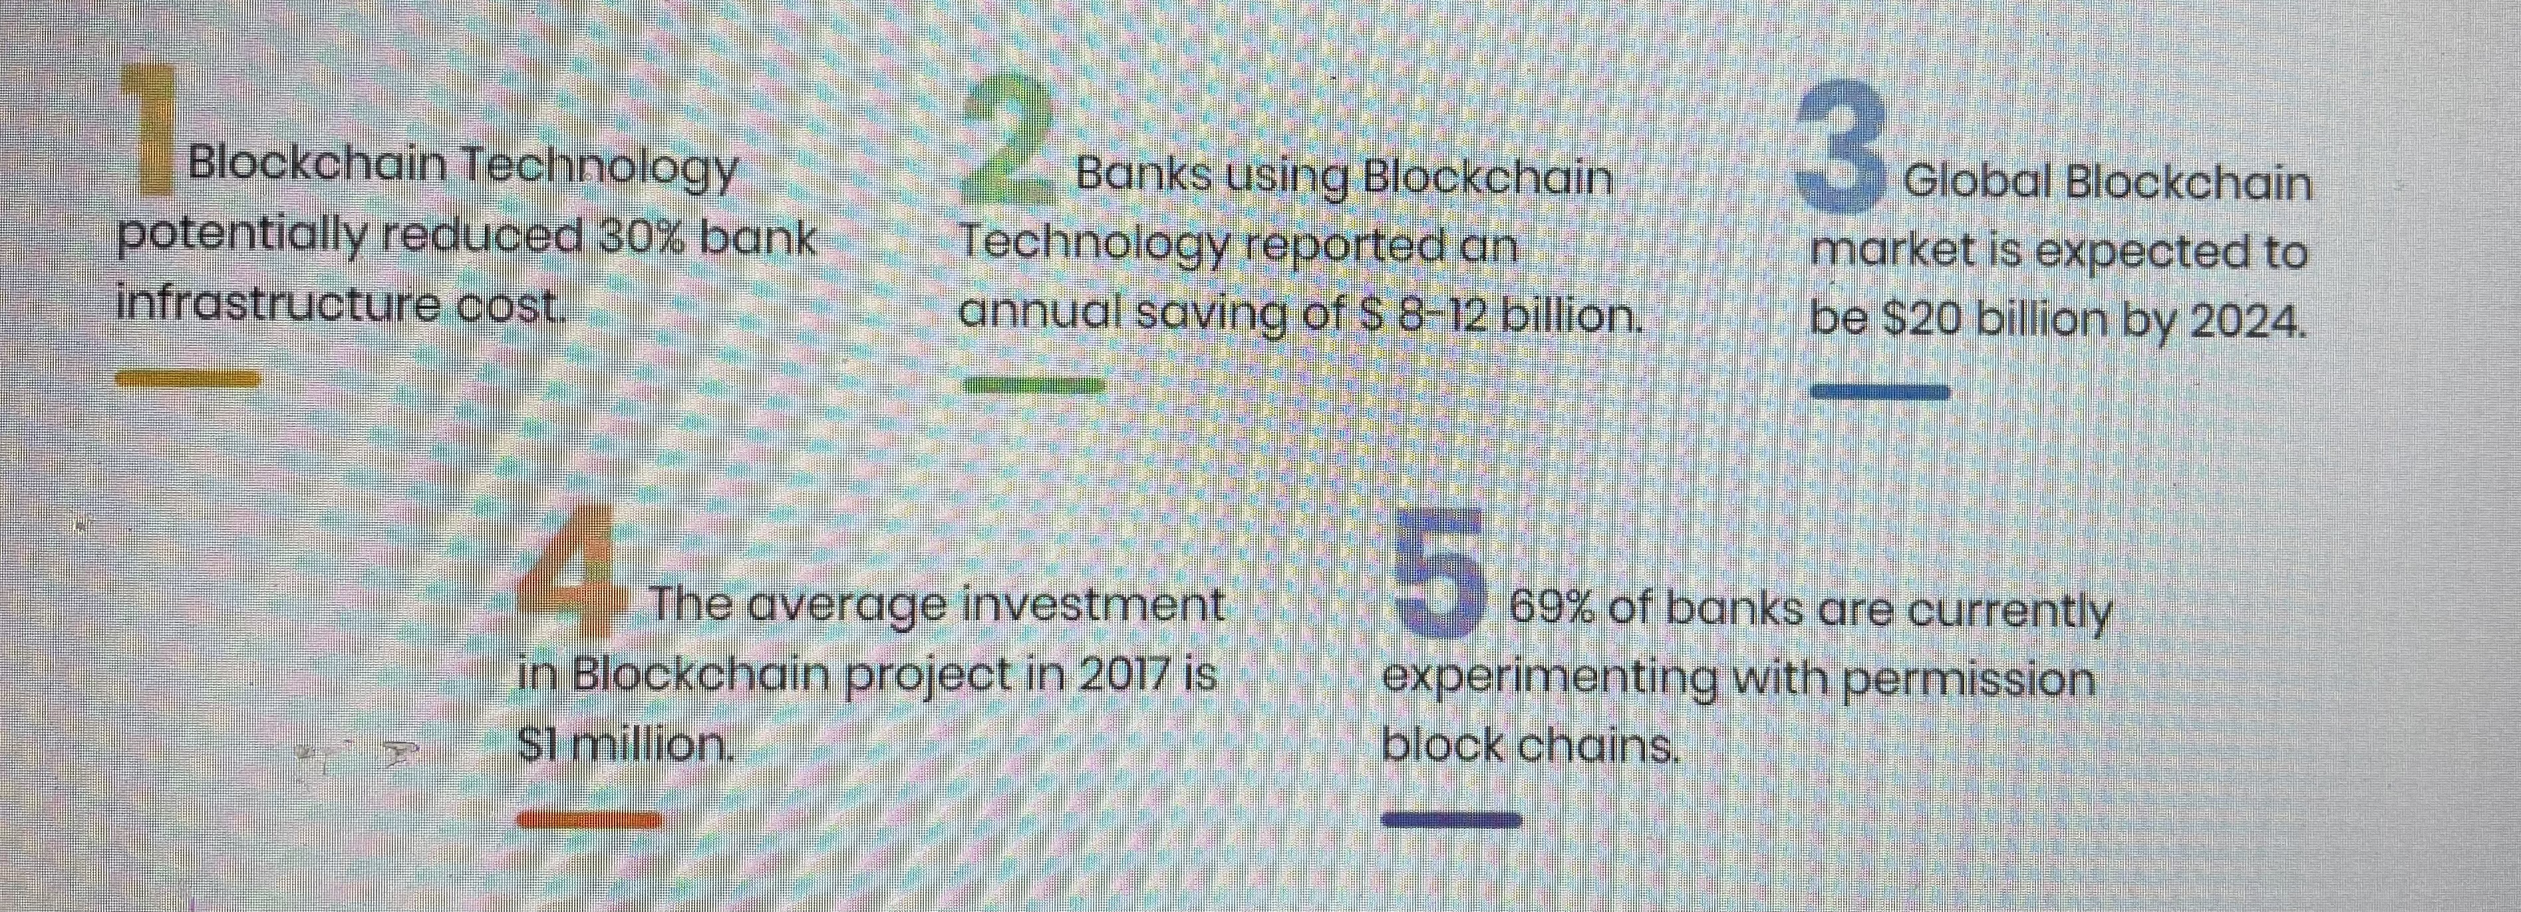
Benefits of Blockchain

Slide 4
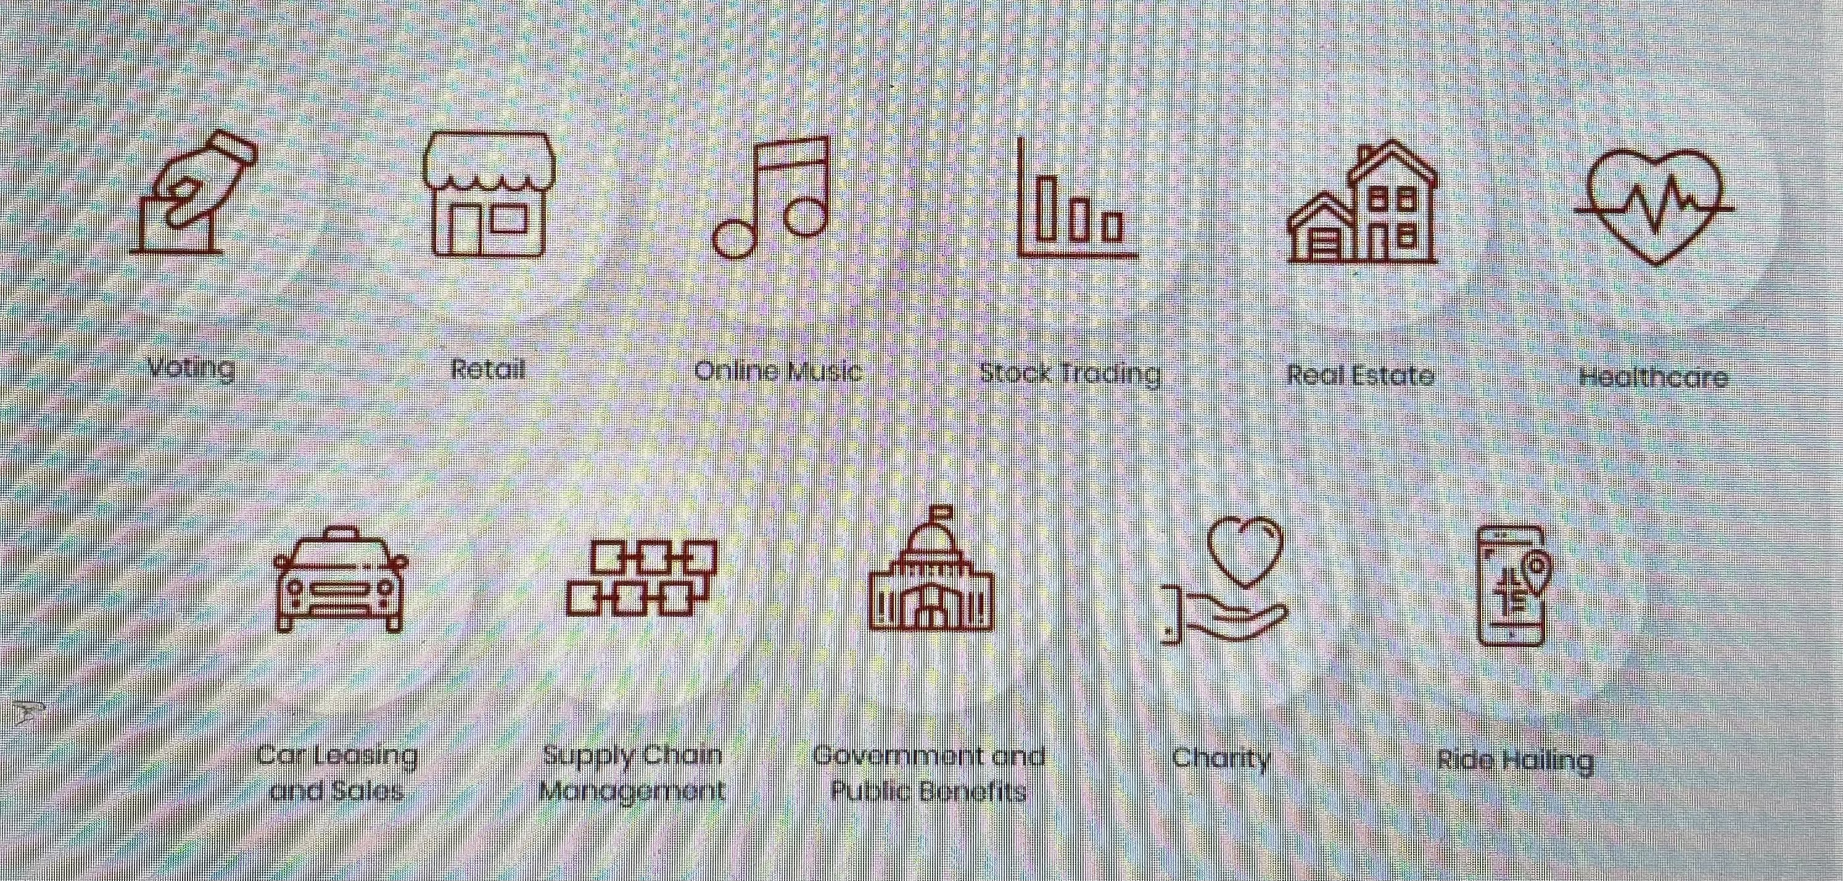
Uses of Blockchain

Slide 5
Deterministic behavior
What is deterministic behavior?
If A + B = C, then no matter what the circumstances, A+B will always be equal to C. That is called deterministic behavior.
Hash functions are deterministic, meaning A’s hash will always be H(A).
So, in blockchain development, all transaction operations must be deterministic. You cannot have a transaction that behaves one way and then behaves another way the next day. Similarly, you cannot have smart contracts that work in two different ways in two different machines.

Slide 6
Examples (1)
#include <iostream.h> main() { cout << "Hello World!"; return 0; }
This code will print” Hello World!”
So, why do people still use C++ for coding? Surely there are way more glamorous languages now, why do people still insist on going back to C++? Why is the bitcoin blockchain coded on C++?
Well, as it happens, C++ has certain features that make it very appealing.

Slide 7
Example (2)
One of the most interesting aspects of C++ is move semantics. Move semantics provides a way for the contents to be moved between objects rather than be copied outright. Let’s check out the differences between copy semantics and move semantics. (Following data are taken from Peter Alexander’s answer in “Stackoverflow”).
Copy Semantics:
assert(b == c);
a = b;
assert(a == b && b == c);
So what is happening here? The value of b goes into a and b remains unchanged at the end of the whole thing.
Now, consider this.
Move Semantics:
assert( b = = c);
move (a,b);
assert (a = =c );

Slide 8
Example (3)
“+” can be used both for mathematical addition and for concatenation.
Concatenation basically means taking two strings and combining them as one.
So 3+4 = 7.
A obj1 //making one object of the class A //now we are going to call the functions obj1.func(2); obj1.func(2.65); obj1.func(2,5); return 0; }

Slide 9
Firstly, we create the genesis block and give its value to “previous_block”.
Then we determine how many blocks to add, in this example we are going with 15.
So we are running a loop that goes till 15 and adds each and every block to the blockchain. At the end of the look, we are printing which number block has been added to the blockchain via showing their index number. Plus, we are printing the Hash as well.
blockchain = [create_genesis_block()] previous_block = blockchain[0] num_of_blocks_to_add = 15 for i in range(0, num_of_blocks_to_add): block_to_add = next_block(previous_block) blockchain.append(block_to_add) previous_block = block_to_add # Tell everyone about it! print "Block #{} has been added to the blockchain!".format(block_to_add.index) print "Hash: {}n".format(block_to_add.hash)

Slide 10
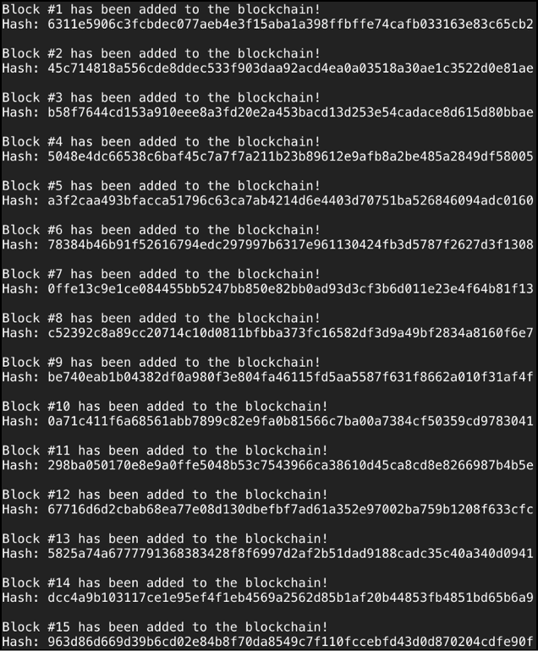

Slide 11
Blockchain Coding: Conclusion
It is practically difficult to corrupt a blockchain because data is shared and constantly accommodated by thousands, even a huge number of PCs, and blockchain has no single point of failure. If one node goes down, it is not a problem since the various nodes have a duplicate of the ledger.
As the world becomes more and more decentralized and blockchain becomes more and more mainstream, the future for you is definitely limitless.

Slide 12
Sources
Blockchain Coding: The Many different Languages You Need! - Blockgeeks
Blockchain Technology Explained (With Infographic) - Tech4Fresher

Slide 13
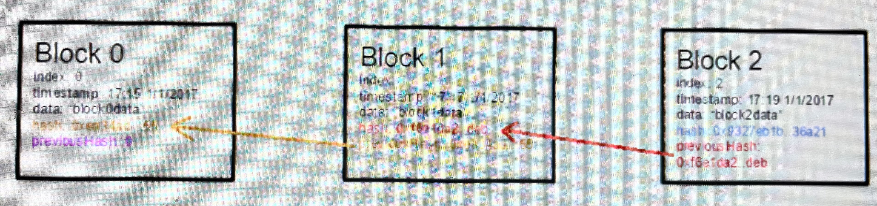
Example (4)
A blockchain is basically a chain of blocks which contain data. It is basically a glorified linked list. However, what makes it so special? A blockchain is immutable. Meaning, once a data goes inside a block, it can never be changed. How does a blockchain attain immutability? It is because of a simple but ingenious mechanism called “hashing”.

